Slide 1




PORT
FOLIO
Hanifah Zahra
an Aspire Data Analyst!

Slide 2


HEY THERE,
ARA IS HERE!
It is my mission to transform raw data into meaningful insights that drive impact and informed decisions.
I specialize in uncovering patterns, building clear visualizations, and turning complex numbers into stories that speak for themselves.

Slide 3



EDUCATION
EXPERIENCE
Full Stack Data Analytics
RevoU
SKILLS
Sales & Account Handler
2025 - 2026
PT Multi Medika Laboratory
Industrial Engineering
Excel
SQL
Python
Tableau
Data Visualization
Communication
2023-2025
Universitas Sumatera Utara
2019 - 2023

Slide 4

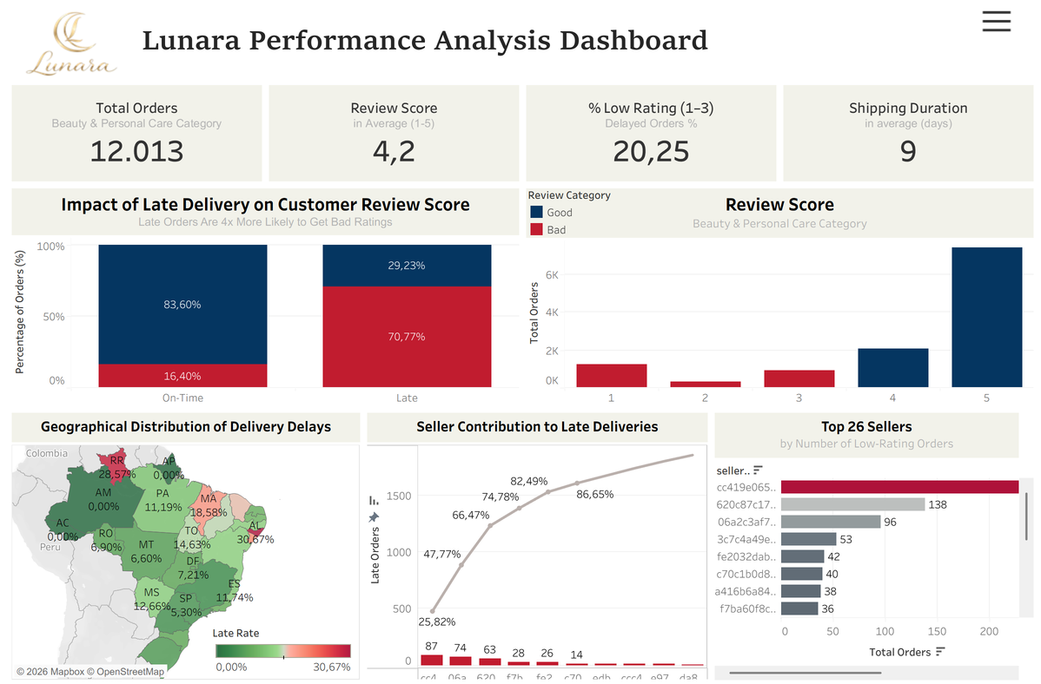

Project Overview
LANURA is a Brazilian Beauty & Personal Care e-commerce platform with 12,013 orders over two years and an average rating of 4.2. However, 20% of orders received low ratings (1–3), indicating potential customer retention risks.
Objective
Identify key drivers of low ratings and design targeted operational interventions to increase the average rating from 4.2 to 4.5 within 12 months.
Tools
Python (Google Colab) and Tableau Public
Key Findings
Delivery delays are the strongest predictor of customer dissatisfaction:
71% of late deliveries resulted in low ratings, compared to 16% for on-time orders
Late orders are 4x more likely to receive poor reviews
5 sellers account for over 80% of total delivery delays
One seller alone generated 400+ low-rating orders
PROJECT
BEAUTY E-COMMERCE PERFORMANCE ANALYSIS
Link to Project

Slide 5
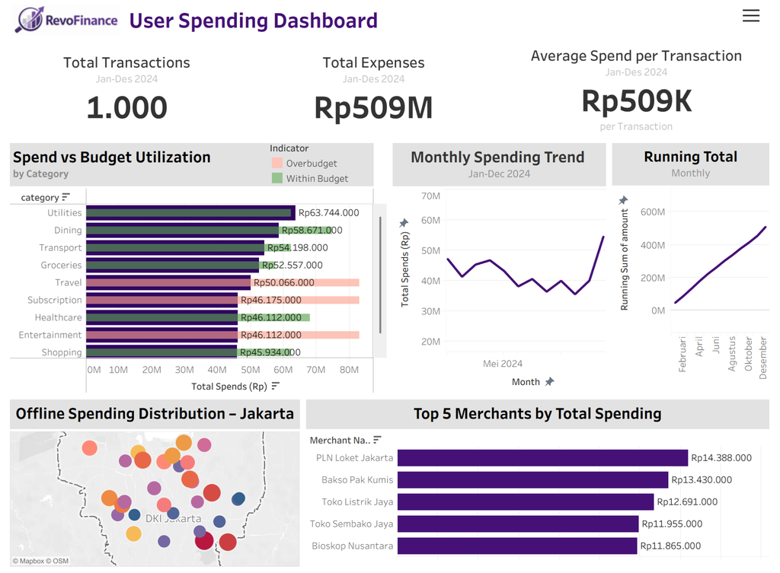
Project Overview
This project involves the development of the RevoFinance Expense & Budget Utilization Dashboard. It is designed for RevoFinance app users to monitor spending, track financial patterns, and improve their overall financial condition. The dashboard provides a comprehensive overview of financial health by comparing actual expenses against planned budgets.
Objective
The primary goal is to help users manage their budgets and make better financial decisions.
Tools
Tableau Public
Key Findings
The project analyzed Rp509M in total expenses from 1,000 transactions, with an average spending of Rp509K per transaction.
A critical insight shows that the Travel and Subscription categories exceeded their planned budgets, reaching approximately 110% utilization.
When grouped, the Education, Entertainment, Subscription, and Travel categories hit a combined budget utilization of 111.1%, indicating a need for stricter controls.
Monthly expenses peaked in December (Rp54M) and were at their lowest in October (Rp35M). Overall, cumulative spending showed a steady increase throughout 2024.
PROJECT
REVOFINANCE: EXPENSE & BUDGET UTILIZATION DASHBOARD
Link to Project

Slide 6





READY TO WORK WITH ME?
+6281260810608
www.linkedin.com/in/hanifah-zahra-fc
hanifahzahrafc@gmail.com

